Slide 1
Global HSSE Project Risk Tools

Slide 2
Objectives
This session introduces the Global HSSE Project Risk Tools and provides guidance on the following:
What Project Risk Tools are available
When to apply the Project Risk Tools
Who should apply the Project Risk Tools
How to use each Project Risk Tool

Slide 3
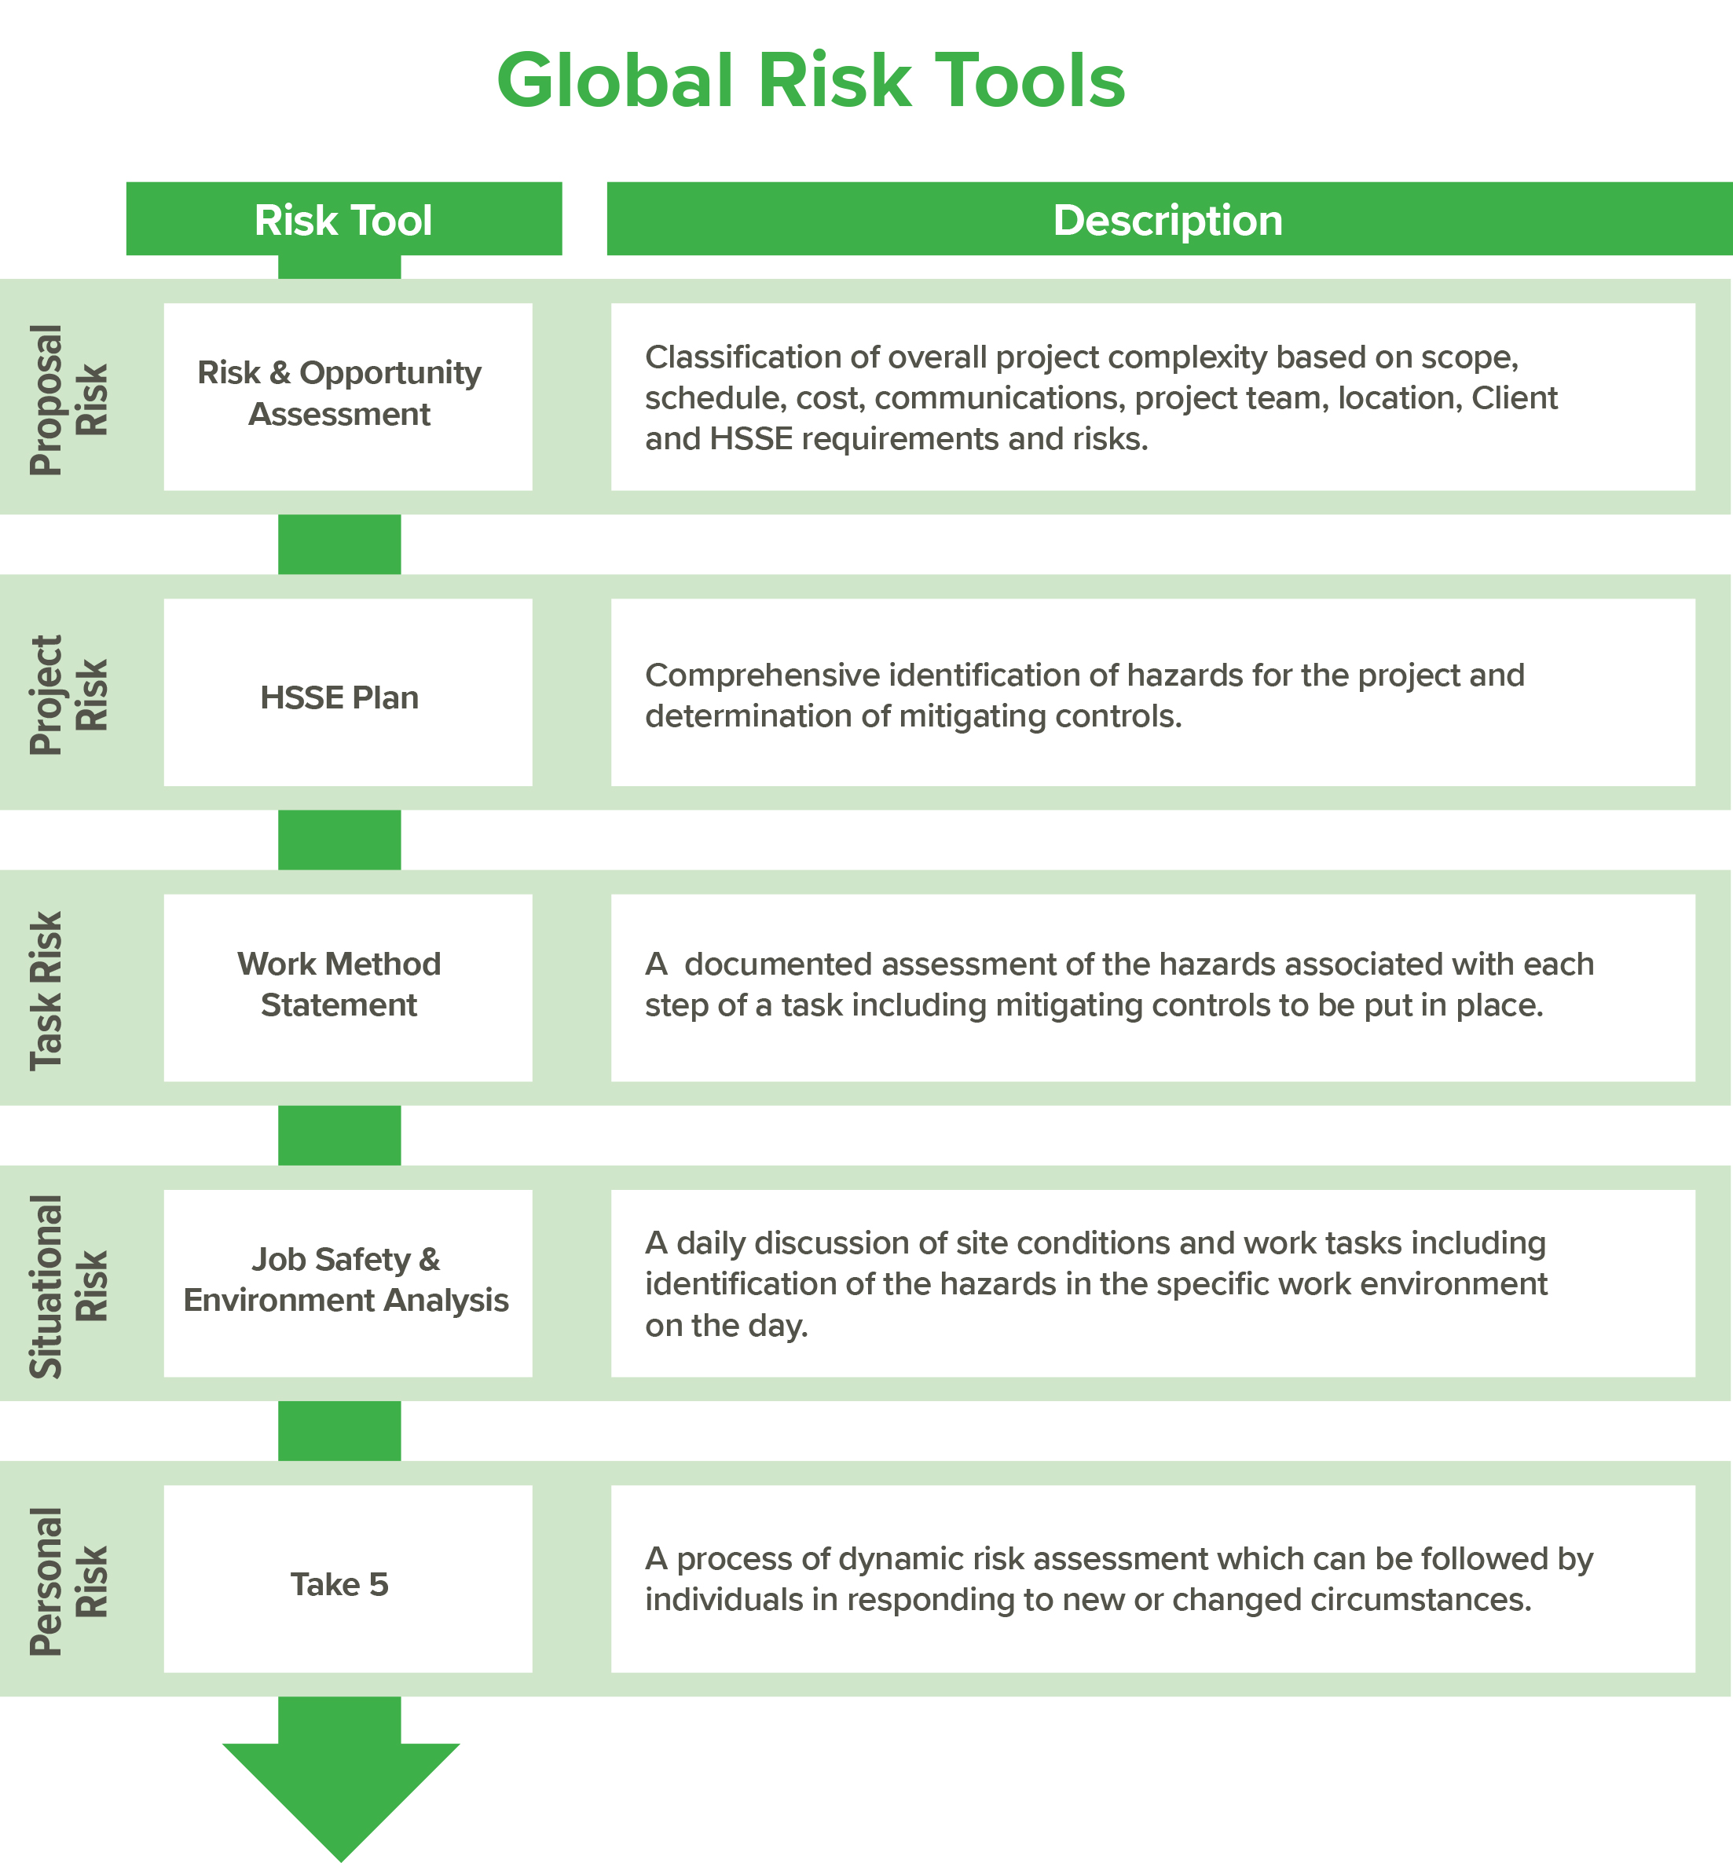
Global HSSE Project Risk Tools
Notes:
We will cover a number of HSSE Risk Tools in this training event. As with many training activities, we will only touch the surface of theses important HSSE Risk Tools. Please, take it upon yourself to understand more by asking one of your HSSE team, an experienced Project Manager or Principal/Associate. They will be able to explain beyond the theory of the tool and discuss the practical implementation. This is where the success of a project is determined. The stronger the understanding of the HSSE risks at the onset, the increased likelihood of completing the project with no incidents, no injuries no damages! The Global HSSE Manual and associated GMPs are another source of valuable background reading to help you further understand these tools.

Slide 4
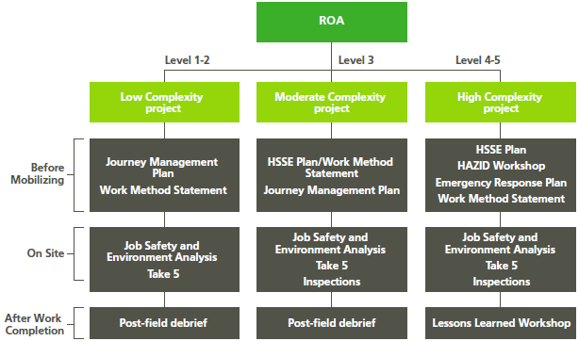
Classification of projects and corresponding risk tools
Notes:
We classify Projects into 3 broad categories; LOW, MEDIUM and HIGH complexity. The HSSE Risk tools we use will be determined by this classification

Slide 5
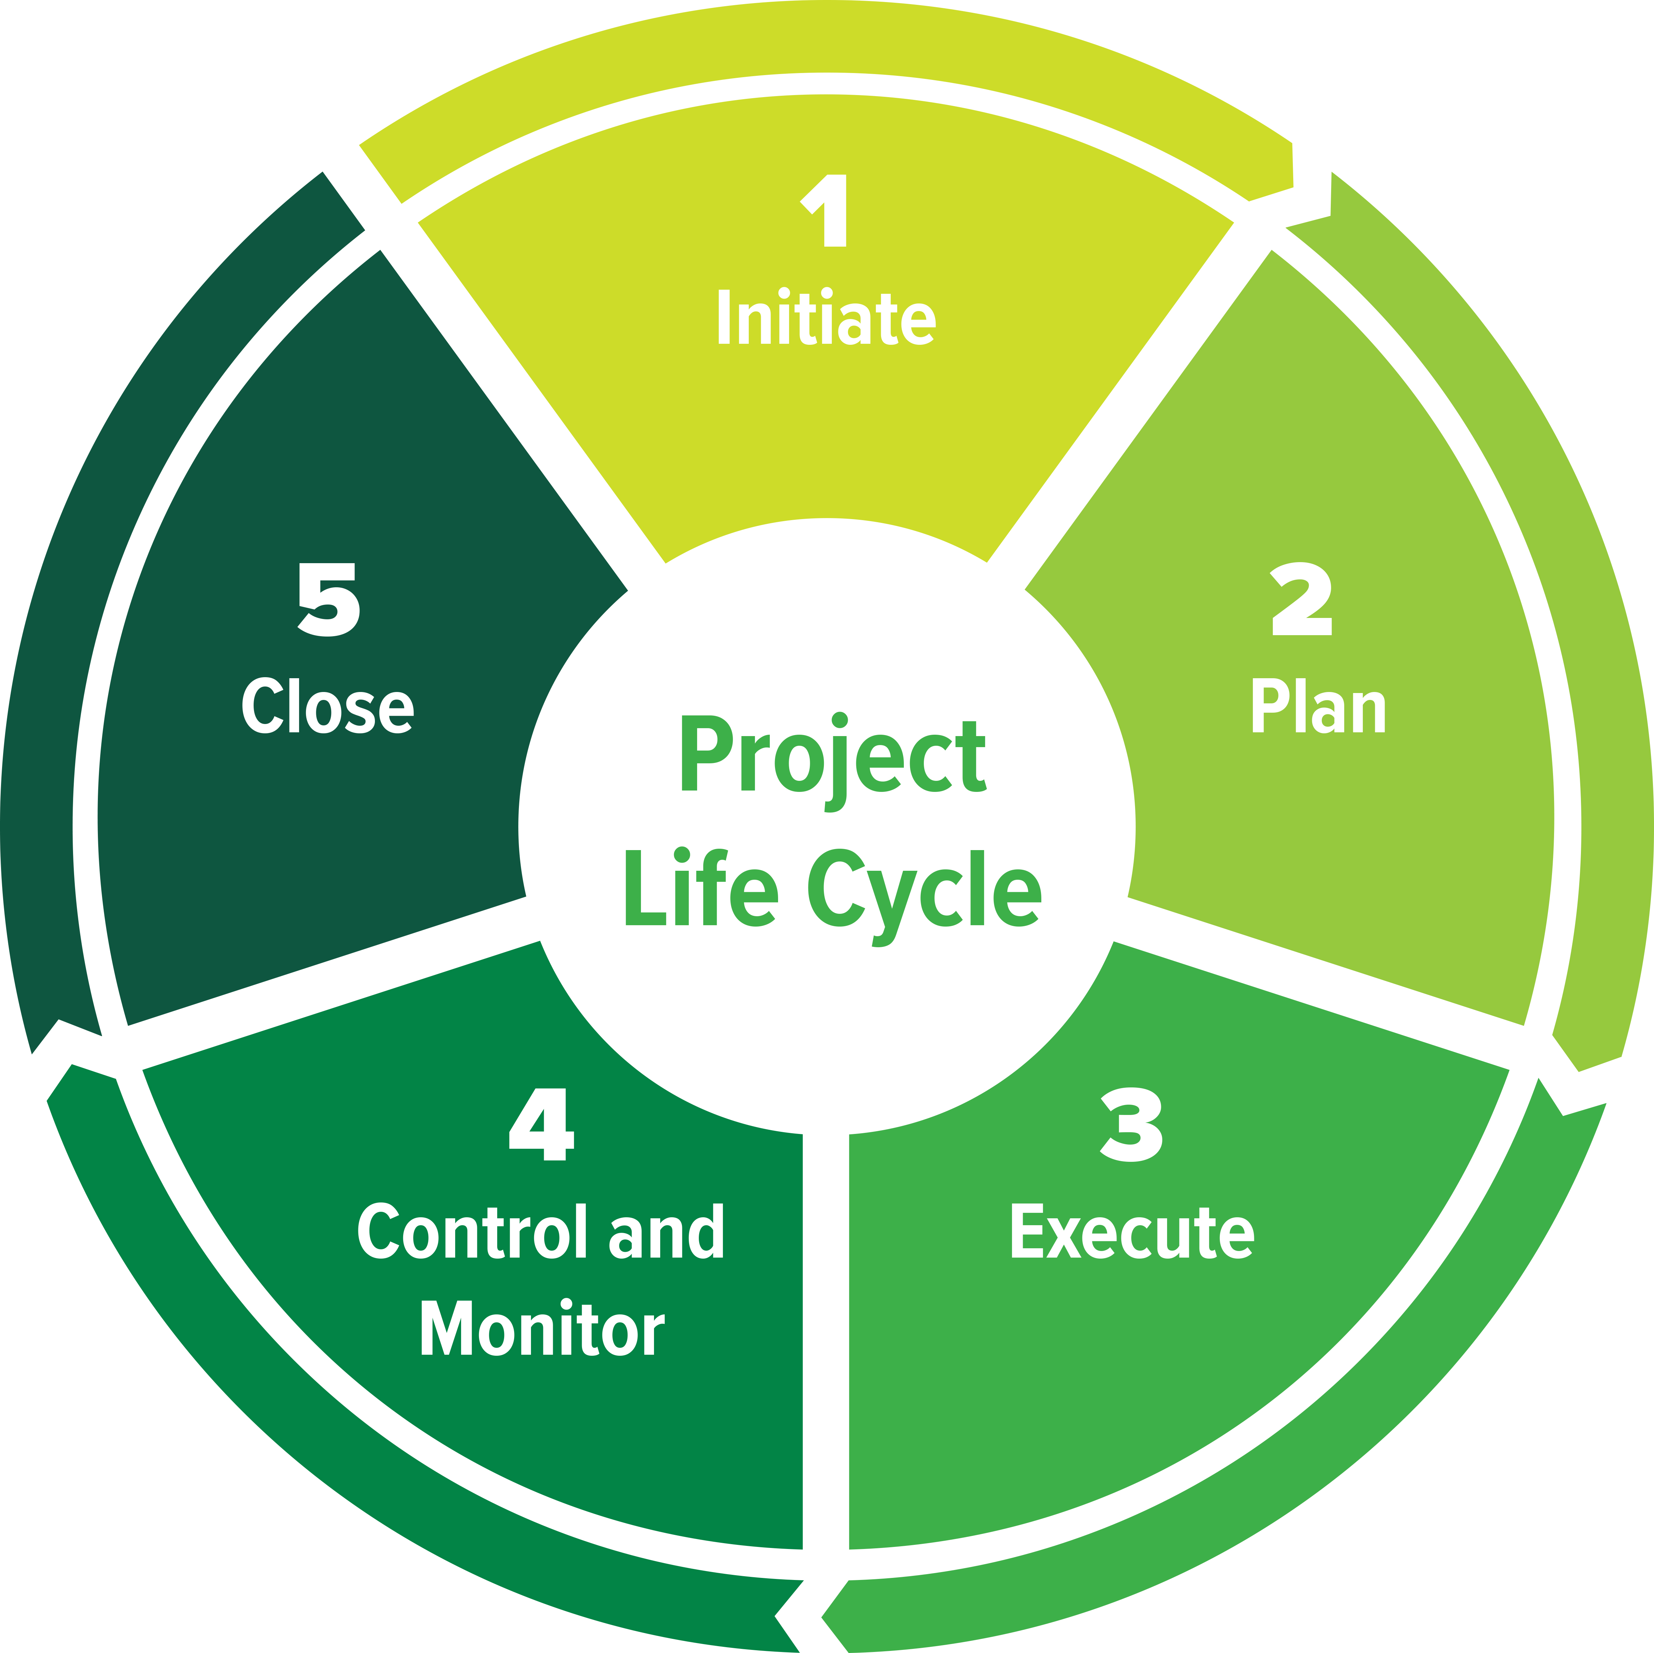
Using the Project Risk Tools through the Project Life Cycle
Initiate the Project
Complete ROA and determine Project Complexity
Determine HSSE resources required
Identify HSSE requirements:
Training and certifications
Personal Protection Equipment (PPE)
HSSE responsibilities and deliverables
Permits and approvals
HRTA if traveling to a high risk travel location
Other client, legal or contractual requirements
KEY TOOLS: ROA, HRTA, Contract
Close the Project
Plan the Work
Demobilize personnel and equipment
Finalize all activities and formally complete the project
Review the project and subcontractor performance
Review learnings and share as appropriate:
Project debrief, or
Lessons Learned Workshop
KEY TOOLS: LDB, Lessons Learned Workshop
Conduct a HAZID Workshop if project is High Complexity
Develop HSSE planning according to project complexity
Full HSSE Plan, or
Combination of risk tools: Journey Management Plan + Work Method Statement
Plan for all foreseeable emergencies
Select an approved subcontractor
Provide required training to the project team
Communicate the risks and controls to employees and sub-contractors
KEY TOOLS: Subcontractor Database, HAZID Workshop, WMS
Monitor Performance
Report all learnings
Conduct regular site inspections and observations as required
Manage the risks associated with any changes to the project
Monitor HSSE performance against the project targets
Conduct project HSSE evaluation if Project is High Complexity
Retain and maintain all HSSE records
KEY TOOLS: Inspections, Project HSSE evaluation
Execute the Work
Make pre-mobilization arrangements
Conduct kick-off meeting
Onboard employees/subcontractors and verification of competency
Onboard equipment where required
Complete a Job Safety & Environment Analysis
Continually apply Take 5 to evaluate the risks
Verify HSSE planning in the field
KEY TOOLS: Kick-off meeting, JSEA, Take 5
Notes:
We should also remember that the HSSE Risk Tools are dynamic; they are available AND should be used at various steps through the Project Life Cycle. Again, reading the Global HSSE Manual will help your understanding of the Project Life Cycle.

Slide 6

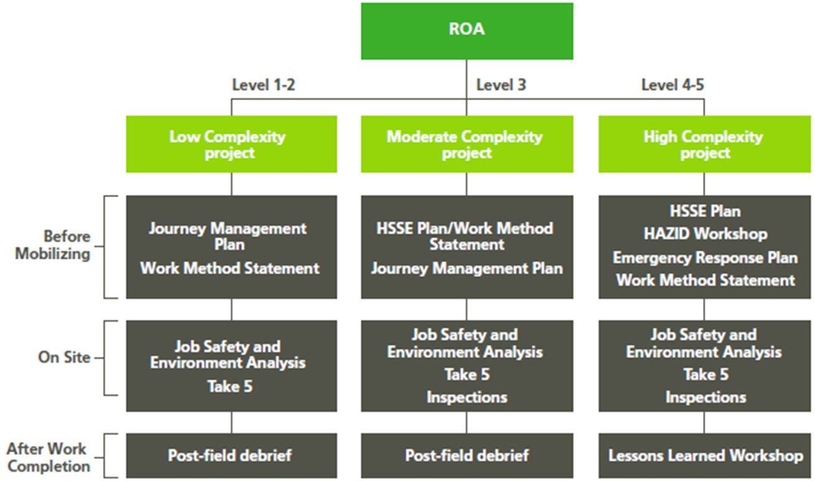
Risk & Opportunity Assessment – Proposal Risk
Notes:
We start with the RISK and OPPORTUNITY Assessment (ROA)

Slide 7
Risk & Opportunity Assessment – Proposal Risk
Risk & Opportunity Assessment
What | Classification of overall project complexity based on scope, schedule, cost, communications, project team, location, Client and HSSE requirements and risks
When | Prior to submitting a proposal
Who | Opportunity Leader
Project complexity | Low, Moderate & High
This assessment of project complexity will help determine the appropriate HSSE Project Risk Tool to use
Notes:
At the project level the Global HSSE Risk Tools provide for a scalable approach that is dependent on the level of project complexity as defined through the ROA process.
Prior to submitting a proposal, an ROA shall be undertaken by the opportunity Leader in accordance with GP1: Project Management to classify the overall complexity of the project based on a number of factors. These factors include the project scope, schedule, cost, communications, HSSE requirements and risks, project team, location, and the Client. The level of complexity obtained from the ROA will determine the approach that can be taken to HSSE planning and execution.
A low complexity project is a project with a ROA Project Classification Level of 1 or 2. Low complexity projects are considered routine projects and make up a large proportion, by number, of our Clients' projects; they are in our core business areas and typically involve one to three disciplines from one or two Golder offices. The work is typically local to the Project Manager's home office, involves few subcontractors, and has a low HSSE risk ranking.
A moderate complexity project is a project with a ROA Project Classification Level of 3. These projects typically involve integrated studies and consulting with multiple interdependencies, and involve project teams over three Golder offices, with several subcontractors. The work is typically national to the Project Manager's home office but may be in a remote location or international, but in a country with a Golder office, or have a Moderate HSSE risk rating.
A high complexity project is a project with a ROA Project Classification Level of 4 or 5. While high complexity projects make up a small proportion of the number of projects in Golder, they account for a large portion of company revenues. They typically have complex scope requirements and integrated service offerings with large project teams over multiple Golder offices, multiple subcontractors, a dedicated Project Manager, or a High or Very High HSSE risk rating. They are often international projects or projects with multiple locations, with corresponding risks to Health, Safety, Security and the Environment and with logistical challenges.
Where a project is created outside of the ROA the definitions for Low, Moderate or High complexity can still be applied to determine the appropriate HSSE risk tools for use.

Slide 8
HSSE Plan – Project Risk Tool Options
Notes:
There are a variety of options available when developing a HSSE Plan.

Slide 9
HSSE Plan
HSSE Plan
What | Comprehensive identification of hazards for the project and determination of mitigating controls. Appropriate to project complexity and risks involved
When | Prior to field work commencing
Who | Project Manager
We will now look at the Project Risk Tools for the HSSE Plan at each level of project complexity
Notes:
An HSSE Plan is a documented plan appropriate to the risk and containing associated documents pertaining to a particular project, workplace or travel event. An HSSE Plan is completed prior to mobilisation to a work site. An HSSE Plan is not required for a project that does not have field work such as a desktop project.
HSSE shall be assessed and controls implemented for each level of project complexity, however the tools to undertake this assessment can change depending on the project complexity. For example, projects with fieldwork need to consider emergency response planning. For low complexity projects this planning may be simply a line item within a Work Method Statement or a Contacts HaSEP while for a high complexity project it may be a dedicated, detailed emergency response plan. An appropriate HSSE Plan may be a stand alone document or a combination of the global risk tools depending on the project complexity.

Slide 10
HSSE Plan – Low Complexity Project

Slide 11
HSSE Plan – Low Complexity Projects
For low complexity projects where our risk exposure is also low, it may not be necessary to create a full HSSE Plan. For example:
An HSSE plan could be a Work Method Statement (WMS) describing the safe completion of a technical task.
Once on-site and prior to commencing work, a Job Safety & Environment Analysis (JSEA) would be completed to verify the site conditions reflect the hazards identified in the Work Method Statement.

Slide 12
HSSE Plan – Low Complexity Projects
For low risk activities, for example undertaking a due diligence audit in a retail store, we may only need to assess the journey to the work site and the means of communication. In these cases a Contacts HaSEP / Journey Management Plan may meet the requirements of an HSSE Plan.
Contact HaSEP / Journey Management templates are region specific. If you have any queries about where these are located just ask your local HSSE Team.

Slide 13
HSSE Plan – Moderate Complexity Project
Notes:
Let’s move to Moderate Complexity. Again we have choices we can make depending on the actual project and logistics

Slide 14
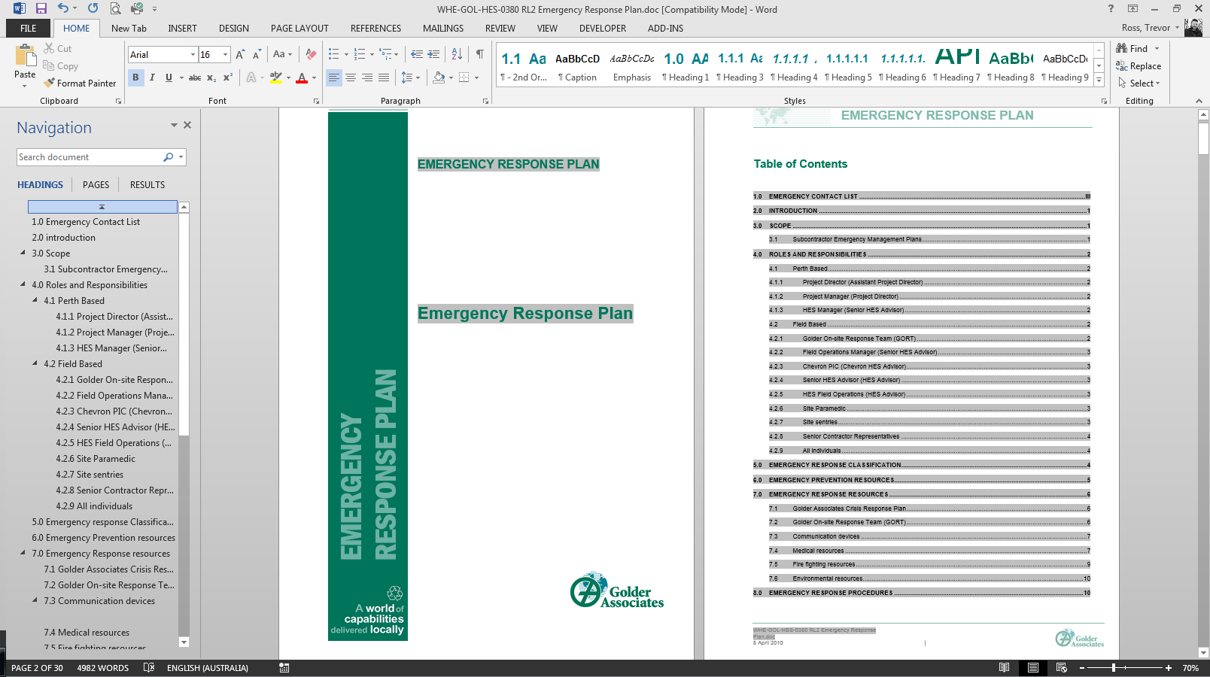
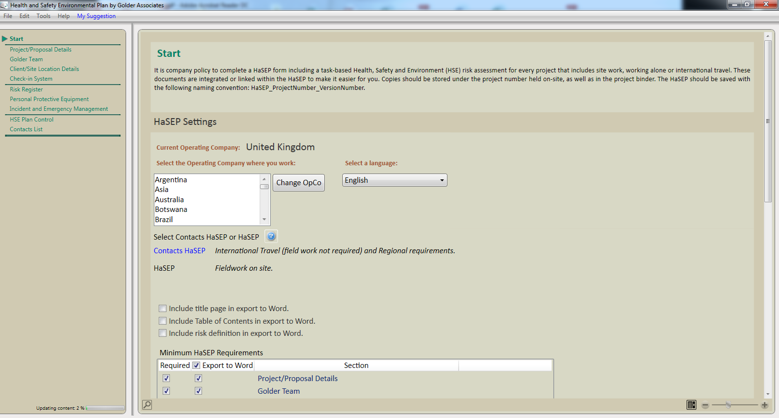
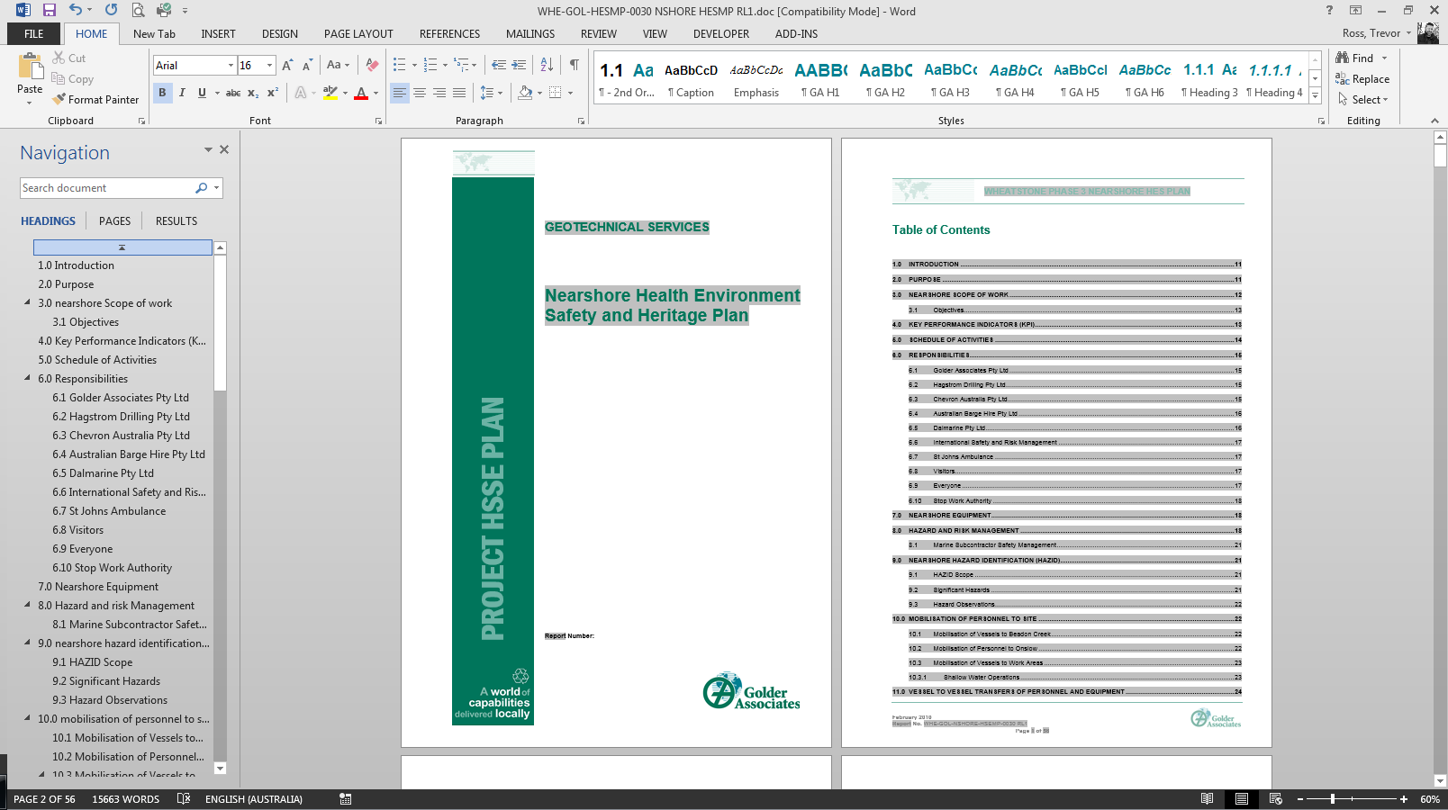
HSSE Plan – Moderate Complexity Projects
Notes:
Moderate complexity projects
For projects of Moderate Complexity, the Project Manager shall determine the most appropriate approach to HSSE planning based on the project scope, location and client HSE standards and requirements.
Use of the electronic HSSE Planning tool, also known as the HaSEP tool, may provide sufficient detail that is appropriate to the risk for some Moderate Complexity projects. Please note that the HaSEP tool has (for efficiency) a number of pre-set options; THE EFFECTIVENESS of the tool will be determined by the effort put into the analysis. The ‘pre-sets’ are not a substitute for critical thinking.
The HaSEP tool output can provide an overarching HSSE Plan and be supported by the use of a Work Methods Statement, JSEA and Take 5 to address specific task, situational and personal hazards and risks.
For some Moderate Complexity projects a more detailed HSSE Plan may be required. For example; where the project involves challenging logistical access, there are multiple regions/teams involved or there is little understanding of project HSSE risks such as with a new site. In these cases the HSSE Plan may require more detail on emergency response, training and competency, or other HSSE issues than can be appropriately identified through the use of the electronic tool. Where a more detailed HSSE Plan is required this shall also be supported by the use of the other HSSE Risk Tools.

Slide 15
HSSE Plan – Moderate Complexity Projects (recap)
Project Manager to determine the appropriate approach to HSSE planning based on the project scope, location and client HSE standards and requirements.
The HSSE Plan for a moderately complex project could be the HaSEP tool, a Journey Management Plan, a Work Method Statement, JSEA or Take 5 (or a combination of these tools).
For some Moderate Complexity projects a more detailed HSSE Plan may be required. For example; where the project involves challenging logistical access, there are multiple regions/teams involved or there is little understanding of project HSSE risks such as with a new site.
Remember - advice is always available from your local HSSE Team.
Notes:
Moderate complexity projects
For projects of Moderate Complexity, the Project Manager shall determine the most appropriate approach to HSSE planning based on the project scope, location and client HSE standards and requirements.

Slide 16
HSSE Plan – High Complexity Project
HSSE Plan – High Complexity Project
Notes:
Although few in total number, High Complexity Projects provide a significant revenue stream to Golder AND a significant risk; we need to be 100% on top of these from a HSSE point of view.

Slide 17
HSSE Plan – High Complexity Projects
Notes:
High complexity projects
High Complexity projects will require a more detailed HSSE Plan. This may include separate plans to address specific HSSE elements, for example a dedicated plan for Emergency Response. High Complexity projects are required to undertake a Hazard Identification (HAZID) Workshop with representatives of key internal and external stakeholders participating. The outcomes of the HAZID Workshop shall be used to determine the HSSE Plan scope and requirements. As with the other project complexities, the detailed HSSE Plan(s) will be supported by the use of the other HSSE Risk Tools.
HSSE shall be assessed and controls implemented for each level of project complexity, however the tools to undertake this assessment can change depending on the project complexity. For example, projects with fieldwork need to consider emergency response planning. For low complexity projects this planning may be simply a line item within a Work Method Statement or a Contacts HaSEP while for a high complexity project it may be a dedicated, detailed emergency response plan.

Slide 18
HSSE Plan – High Complexity Projects (recap)
High Complexity projects require a more detailed HSSE Plan than can be provided through other tools (e.g. HaSEP) and may include additional plans to address specific HSSE elements, for example a dedicated plan for Emergency Response.
High Complexity projects are required to undertake a Hazard Identification (HAZID) Workshop with representatives of key internal and external stakeholders participating.
The outcomes of the HAZID Workshop shall be used to determine the HSSE Plan scope and requirements.
As with other project complexities the detailed HSSE Plan(s) will be supported by the use of the other HSSE Risk Tools.

Slide 19

Project Risk Tools Checklist
 Journey Management Plan
 Work Method Statement
 Job Safety & Environment Analysis
 Take 5
Notes:
Now a few practical applications…

Slide 20
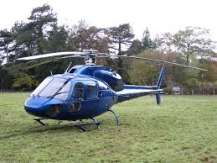
Why Do We Need a Journey Management Plan?
1991
2001
2012
Notes:
[Time the descriptions of events to the pictures on screen]
It is widely recognized that journeys are among the highest risk activities regularly undertaken in our industry. Furthermore, a number of our most significant incidents, including 3 fatalities have been related to journey management.
Peter Giam, February 1991. Working in a Century Zinc project in NW Queensland. Peter was very interested in helicopters and engaged with the pilot who decided to show off his skills and the helicopters capabilities. Peter was killed when the helicopter went down.
In April of 2001 while driving back from a site in Yallourn to Melbourne, Scott Brooks fell asleep at the wheel, clipped another car, rolling his vehicle. Although Scott’s colleague in the passenger seat survived, Scott did not.
In the winter of 2012, Conrad Bruno died of severe hyperthermia travelling home from a remote work site. There were a number of factors that led to this tragic outcome, but the company vowed to put in place processes and systems to ensure the continued health and safety of our people.

Slide 21
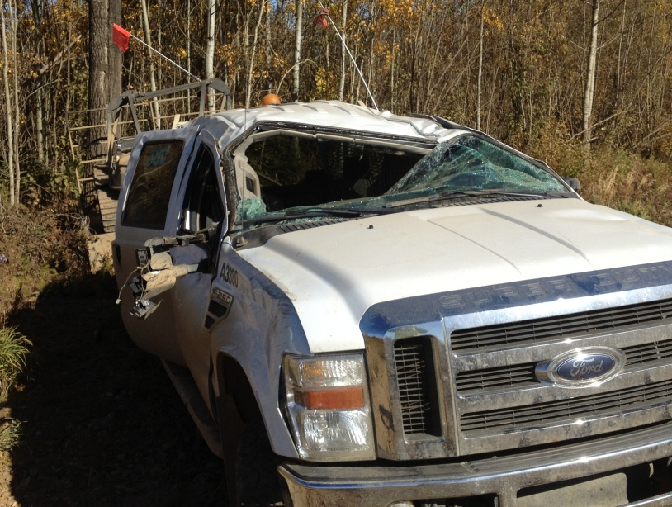
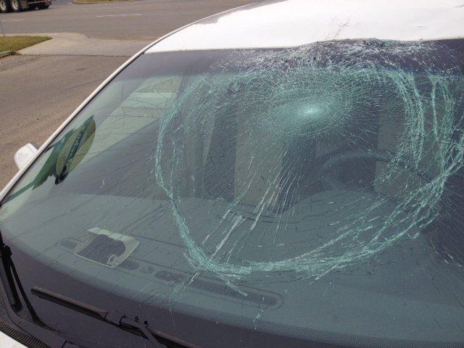
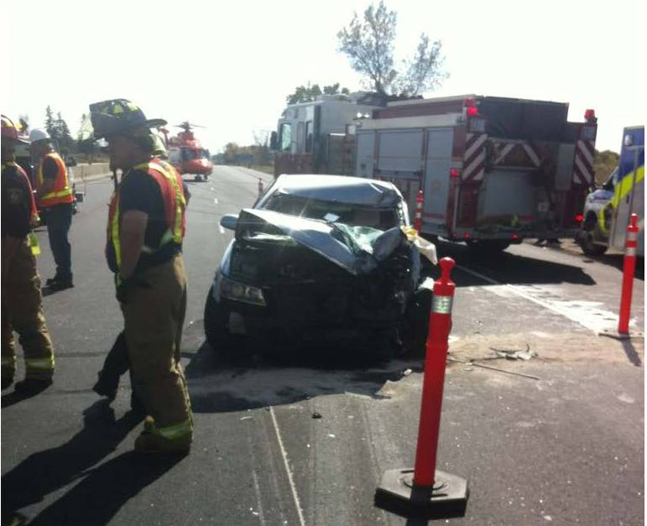
Planning the Journey to Site
Planning Commensurate With the RisK
Remoteness
Road / weather conditions
Personal security factors (e.g. time of day)
Vehicle
A Journey Management Plan helps us respond in a timely manner!
Notes:
In our journeys, risks are presented by the mode of transport used, the route taken and the environment through which the travel is taken.
Employees undertaking work related travel must be aware of the associated hazards and the preventive measures required to ensure their continued health, safety and well-being and protection of the environment.
Not all journeys need a documented JMP (but all need some thought)
When do we need to prepare a Journey Management Plan?
If you are reliant on Golder initiating the response to an emergency during your journey – you need a documented JMP so your journey can be monitored. The JMP will be commensurate to the risks involved and it can be prepared as a stand alone document, or included in the project HSSE plan. For example, if you are traveling to another Golder office in your country, an email to your check-in contact or manager with expected departure and arrival times, contact information and check in frequency may be sufficient.
Our journey management process does not apply to the regular commute to and from the home office but will cover the travel from the employee to a project work site, client’s office, conference venue or any other location where there are risks that need to be managed.

Slide 22

Journey Management
Key aspects
Planning the Journey
Preparing for the Journey
Undertaking the Journey
Completing the Journey
Planning the Journey
DEVELOP A JOURNEY MANAGEMENT PLAN
Conduct a risk assessment considering the route, mode of transport, operator, schedule, etc.
Identify risk rating in International SOS page
If location rated as High risk, follow the High Risk Travel process
Identify possible emergencies and necessary resources
Develop a Journey Management Plan appropriate to the identified risks
Key Tools: ROA, iSOS, HRTA, JMP
Notes:
There are 4 key aspects of journey management that will help you ensure a safe journey: the planning, the preparation, undertaking the journey, and sharing learnings after the journey is completed.
Many of our journeys are routinely through highly populated areas where emergency response will be quick and people are around to call for help. But what if you are travelling through a remote area, areas where access is difficult, or population density is low? How about the condition of the roads and the impact of weather conditions? Consider consulting with local office or colleagues familiar with the chosen route if there are any unknown risks that may need to be mitigated.
When planning the journey think of risk factors such as
Remoteness.
Road / weather conditions.
Personal security factors (e.g. time of day).
Vehicle
Emergency equipment
When traveling by air, choose the highest rated airline whenever possible. If a part of the journey includes a charter airline (contracted by Golder or the client) contact the HSSE team to conduct a risk assessment. For helicopter use a risk assessment commensurate to the risks associated must be completed. Contact the HSSE team for assistance with this type of assessment.
Are you traveling to or through an area where there is a security risk? If you are, there is a high risk travel process that you will need to follow.

Slide 23
Planning the Journey
Using the journey management plan (jmp)
CHECK IN
Departure/arrival location and estimated time
Rest breaks/check-in times on route
Golder check-in contact
Mode of transportation (vehicle type and license if applicable)
COMMUNICATION
Forms of communication (are they set up properly?)
Contact numbers
Alternative contact at destination
Black spots at destination and on route
CONTINGENCY
Navigational aids
Vehicle emergency equipment
First aid kit (special for remote locations)
Emergency information
Notes:
Whenever you travel, you will need a Journey Management Plan, however the detail involved will depend on the risk associated with the travel. Our journey management process does not apply to the regular commute to and from the home office but will cover the travel from the employee to a project work site, client’s office, conference venue or any other location where there are risks that need to be managed.
It could all be recorded on a single page that includes a check-in procedure, hazards associated with the travel and actions to be taken before the trip.
What should the JMP include?
It’s a Combination of Three C’s
Checking-in with your PM or contact person at agreed times. Before departing travelers must share their itinerary with their contact and agree on the check-in times.
Ensuring appropriate means of communication. This includes bringing a suitable device, verifying the area coverage for the method of communication selected and that we know how to use it. Charging equipment and back up batteries should also be considered.
Planning for foreseeable contingency situations. This means packing emergency equipment such as fire extinguisher, a first aid kit, sufficient food and water and vehicle recover equipment. Think of the weather and road conditions that you may encounter .

Slide 24

Journey Management
Key aspects
Planning the Journey
Preparing for the Journey
Undertaking the Journey
Completing the Journey
Preparing for the Journey
Verify controls and contingency preparedness
Send itinerary to trips@golder.com
Select the best communication device for the location (SPOT, sat phone, radio…)
Verify that emergency equipment are available and in good working condition: First Aid kit, spill kit, survival kit, etc.
Print out the JMP and ensure you understand all the information contained in it.
Download the International SOS mobile app
Key Tools: JMP, Communication Devices, Emergency Equipment

Slide 25

Journey Management
Key aspects
Planning the Journey
Preparing for the Journey
Undertaking the Journey
Completing the Journey
Undertaking the Journey
FOLLOW THE JMP
Verify communication devices and emergency equipment are working properly.
Check weather conditions
For road trips, ensure a pre-use inspection of the vehicle is completed
Notify your check-in contact when the trip has commenced and at the agreed times.
Check-in with International SOS mobile app
Monitor risks throughout the journey
Key Tools: JMP

Slide 26

Journey Management
Key aspects
Planning the Journey
Preparing for the Journey
Undertaking the Journey
Completing the Journey
Completing the Journey
DEBRIEF AND SHARE LEARNINGS
Post-trip inspection to identify necessary repairs.
Debrief to report and share information about the trip.
Report any near misses so that improvements can be made.
Review of transport service where applicable e.g. contract driver.
Key Tools: LDB

Slide 27
JOURNEY MANAGEMENT EXERCISE

Slide 28
Planning Your Journey
A JMP exercise
Consider the following scenario and answer the questions shown:
Golder employee to travel to a remote site to conduct an inspection and meetings with the client.
The visit is expected to take 1 week onsite
Traveler takes a domestic fly (1.5 hours) to the nearest community.
Traveler rents a car and drives 2 hours to site on low transited highway.
There is no mobile reception on the road leading to the site.
International SOS risk rating is low.
Notes:
Consider the following scenario and answer the questions that will show on the screen.
[read slide]

Slide 29
Answer the following questions:
Does the traveler need to develop a written Journey Management Plan for this visit?
No, because the travel time will be relatively short.
Yes, because he is traveling alone to a remote location with no cellphone coverage.
No, because it’s a domestic trip.
No, because the International SOS rating is low
Does the traveler need to bring any emergency equipment?
Yes, they should bring a First Aid kit, Fire Extinguisher and means of communication.
No, because they are driving a rental car.
Notes:
1 Yes. Because he is traveling alone to a remote location with no cellphone coverage.
2 Yes

Slide 30
Answer the following questions:
What additional aspects should the traveler consider? Check all that apply.
Establish a check in procedure
Bring appropriate communication device
Inspect the vehicle prior to use
Complete a Project High Risk Travel Assessment
Check weather forecast
Bring sunglasses and bathing suit
Send itinerary at trips@golder.com
Notes:
3
Not applicable:
Bring sunglasses and bathing suit
Complete a Project High Risk Travel Assessment

Slide 31
Project Risk Tools Checklist
 Journey Management Plan
 Work Method Statement
 Job Safety & Environment Analysis
 Take 5

Slide 32
Work Method Statement
Work Method Statement
What | Documented assessment of hazards associated with each step of a task including mitigating controls to be put in place
When | Prior to a task commencing
Who | Task owner and personnel undertaking the task
Notes:
A Work Method Statement is a documented assessment of the hazards associated with each step of a task including mitigating controls.
As demonstrated in the previous slides a Work Method Statement may be suitable as an alternative to a HSSE Plan for low complexity projects as well as suitable as a supporting risk tool for more complex projects. In some regions completing a Work Method Statement is a legislative requirement.
At a minimum, Work Method Statements shall be developed for activities, equipment and machinery where there exists a risk of significant harm to a person or the environment, or where administrative controls have been identified during the risk assessment process, or where hazards can not be mitigated by engineering controls.
Where a Work Method Statement is required it shall be completed before starting the task and personnel involved in the task shall be included in the development of the Work Method Statement.

Slide 33
Work Method Statement
A WMS assists you with planning and also with monitoring the risks related to the tasks.
A WMS Contains Information On:
Main steps involved in the task in sequential order
A list of hazards associated with work
Risk controls to manage these hazards
How the controls will be implemented
A WMS Is Required For:
High risk activities
Activities not included in the project HSSE Plan
Other activities specified by the Client or Prime Contractor
Notes:
During the planning phase of a project, key risks associated with the work to be performed must be identified and controls implemented. The WMS is one of the tools at our disposal to assist with planning and also with monitoring of risks related to the project tasks.
It may be used to complement the HSSE Management Plan or it can replace the project HSSE plan in combination with a Journey Management Plan in those Low complexity projects that are simple and short duration.
Work Method Statements are required for
High risk activities
Activities not included in the project HSSE Plan
In some cases developing a WMS may be a client requirement, they may call it Job Hazard Analysis, Job Safety Analysis or equivalent
They can also be used at any other time as needed.

Slide 34
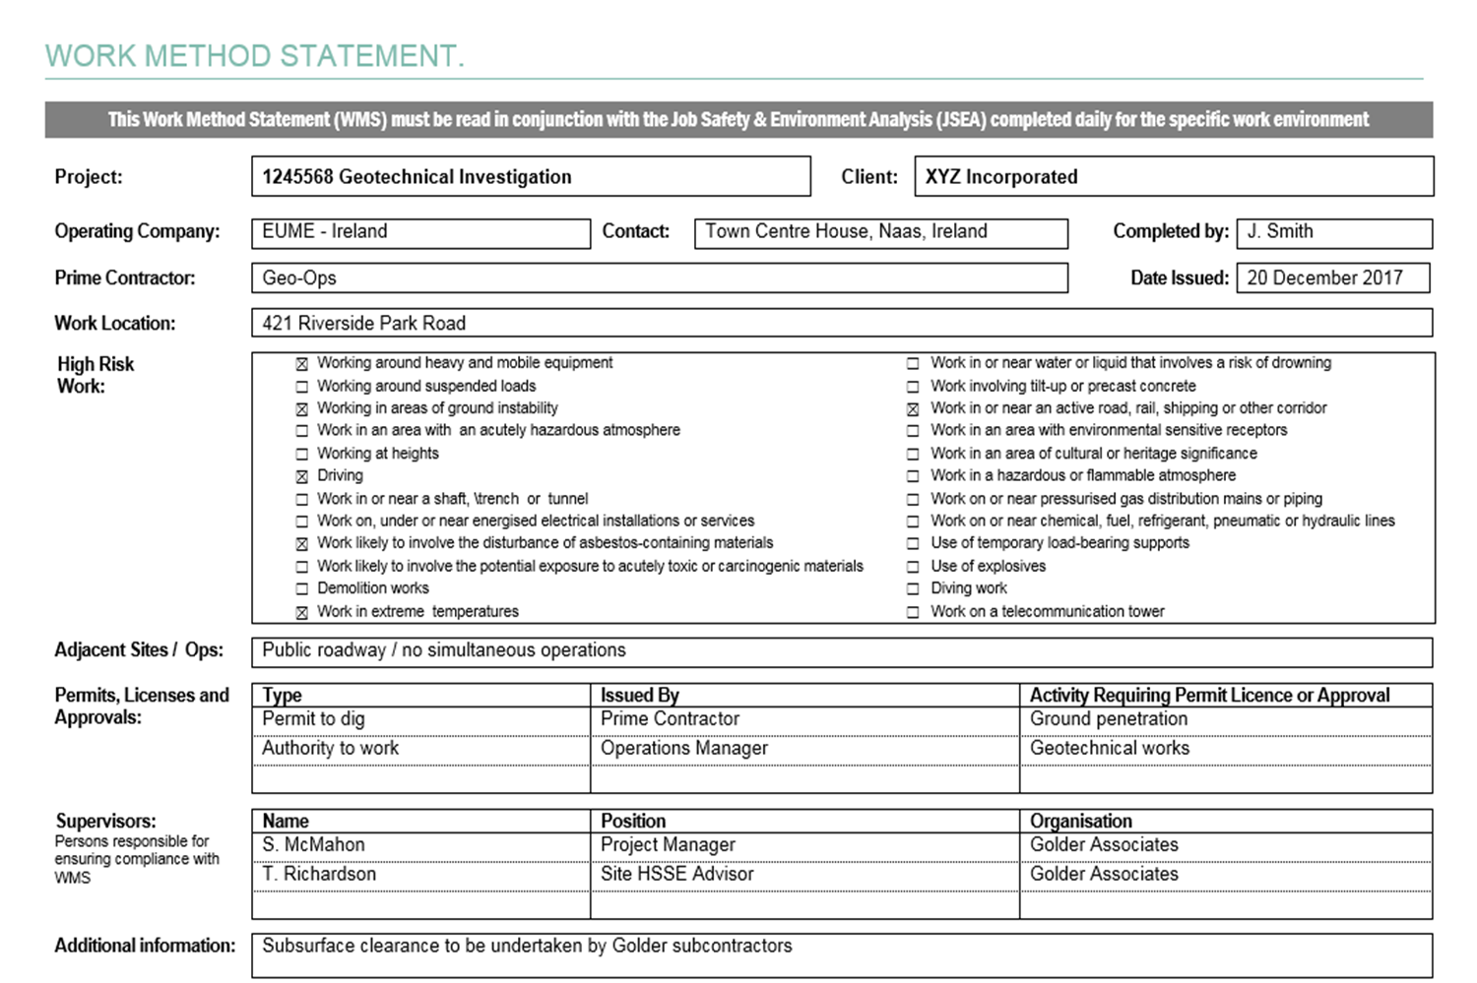

Notes:
A Work Method Statement provides the employee, and in some cases the team, with an understanding of the hazards, risks and controls required to safely undertake a task.
For example a Work Method Statement identifies:
The project, client and Golder team details
The permits and licenses required and
The responsibilities

Slide 35
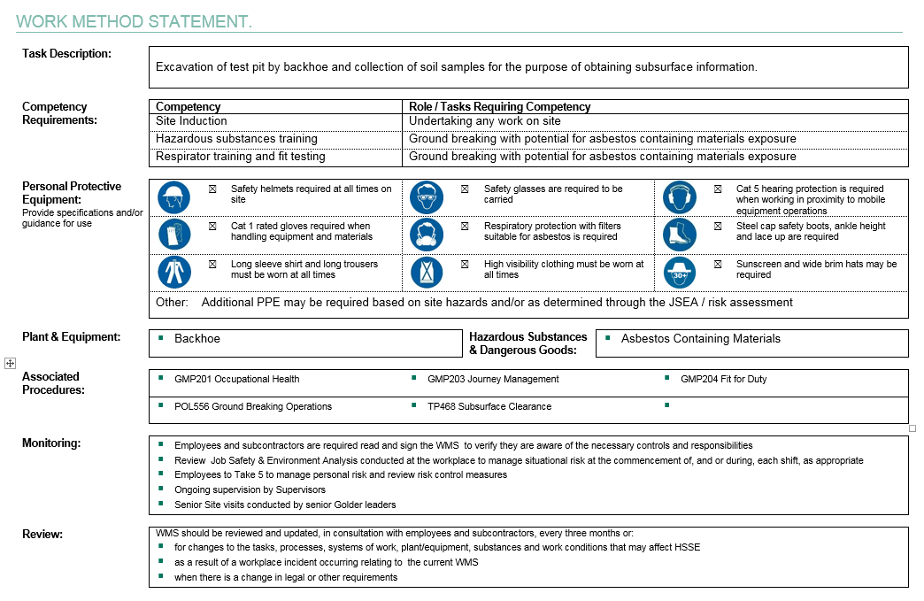


Notes:
The Work Method Statement also specifies:
Competency requirements
Personal Protective Equipment
Plant and equipment requirements and
Procedures and standards with which the work is required to comply

Slide 36
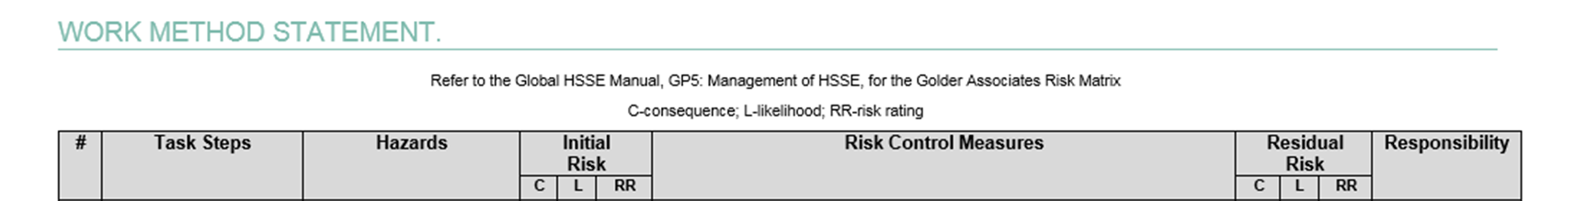
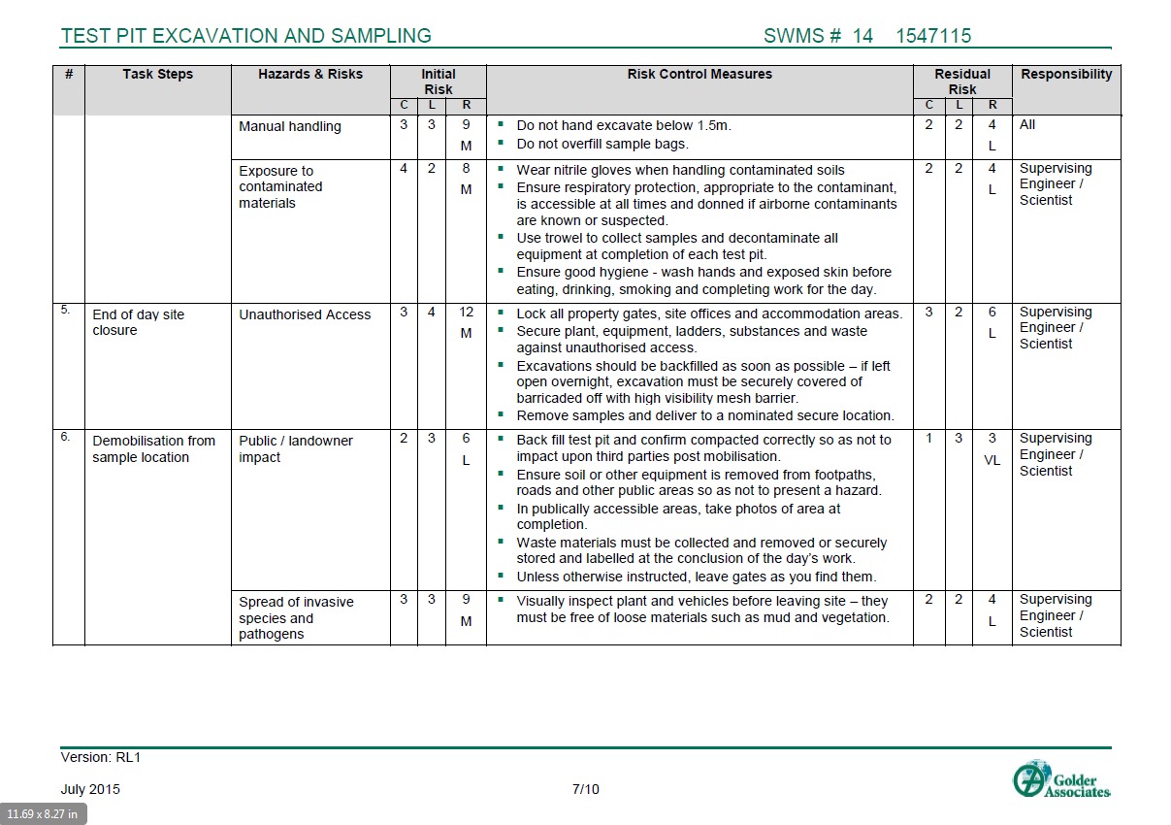
Notes:
The Work Method Statement includes a risk assessment element that identifies:
The main steps involved in completing the task
A list of hazards associated with work
Controls to be implemented to effectively manage the hazards and
How the controls will be implemented, monitored and reviewed
A Work Method Statement should be short and focus on describing the specific hazards identified for the task to be undertaken and the control measures to be put in place so that the work is carried out safely. A lengthy or overly detailed Work Method Statement can be difficult to understand, or to apply, monitor or review.

Slide 37
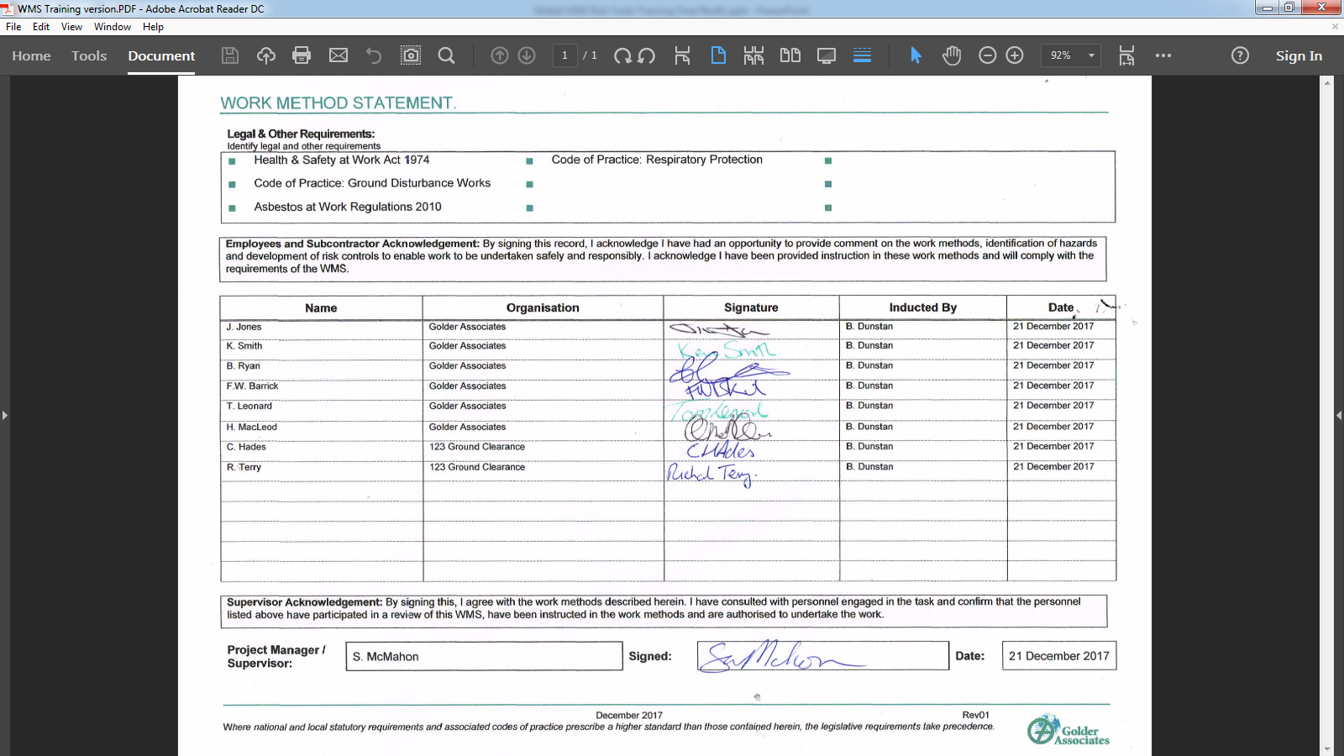
Notes:
The final page of the Work Method Statement identifies legal and other requirements applicable to the project or task.
As with a HSSE Plan, each person performing a role in the task are required to read and sign the Work Method Statement to understand and verify awareness of the controls and their responsibilities.
Final sign off of the Work Method Statement shall be made by the Project Manager or Supervisor confirming they agree with the work methods identified and that personnel involved have been consulted and instructed in the Work Method Statement content.

Slide 38
WORK METHOD STATEMENT EXERCISE

Slide 39
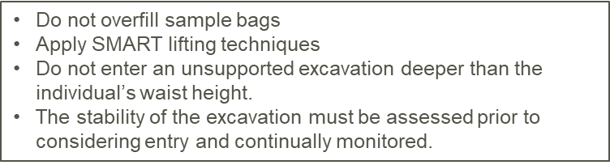

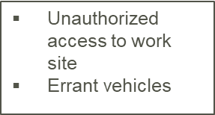
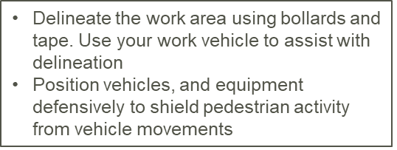
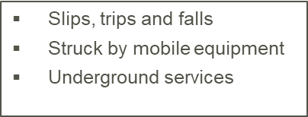
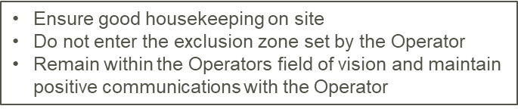
Work Method Statement Exercise
Drag the following items to the appropriate column in the WMS for Test Pit Excavation and Sampling:
TASK STEPS | HAZARDS | CONTROLS
Undertaking logging and sampling
Establishing the Work Site
Supervising excavation of test pit
Notes:
[Place all items scattered around the screen. User will drag them to the correct location on the table.]

Slide 40
Work Method Statement Exercise
Drag the following items to the appropriate column in the WMS for Test Pit Excavation and Sampling:
TASK STEPS | HAZARDS | CONTROLS
Establishing the work site | Unauthorized access to work site Errant vehicles | Delineate the work area using bollards and tape. Use your work vehicle to assist with delineation Position vehicles, and equipment defensively to shield pedestrian activity from vehicle movements
Supervising excavation of test pit | Slips, trips and falls Struck by mobile equipment Underground services | Ensure good housekeeping on site Do not enter the exclusion zone set by the Operator Remain within the Operators field of vision and maintain positive communications with the Operator
Undertaking logging and sampling | Manual handling Excavation collapse / engulfment | Do not overfill sample bags Apply SMART lifting techniques Do not enter an unsupported excavation deeper than the individual’s waist height. The stability of the excavation must be assessed prior to considering entry and continually monitored.
Notes:
[Place all items scattered around the screen. User will drag them to the correct location on the table.]

Slide 41
Project Risk Tools Checklist
 Journey Management Plan
 Work Method Statement
 Job Safety & Environment Analysis
 Take 5

Slide 42
Job Safety & Environment Analysis
Job Safety & Environment Analysis
What | Used to assess situational risk including workplace conditions, work tasks and hazards
When | At the beginning and as required throughout the work day
Who | Personnel undertaking the task
Notes:
Although we plan in advance for the hazards and risks that we anticipate, workplace conditions or tasks can and do change. For example, when we arrive at a project site to complete a task we find that something unexpected is present such as nearby machinery in operation, or unexpected work is being carried out, or a new contractor is on the site.
A Job Safety and Environment Analysis, or what we will call a “JSEA”, addresses situational risk and verifies that the actual workplace conditions encountered are reflective of those identified in the HSSE Planning phase and that the controls are appropriate to the current situation. The role of the JSEA is to verify that we have controlled the actual hazards that we encounter at the workplace.

Slide 43
Job Safety & Environment Analysis (JSEA)
The JSEA is a Communication Process
To be successful you need to:
Know your information and the audience
Involve others and listen to suggestions
Keep it positive and enthusiastic
Check for understanding
Notes:
The JSEA is a communication process, and to be effective you need to:
Know your information: understand the scope of work, hazards, control measures and any previous or likely issues.
Involve others: Listen to workers and show this through your body language.
Check for understanding: use short, straightforward, simple wording, and avoid slang/jargon. Ask workers to run through what you have said using open ended questions in order to demonstrate their understanding.
Keep it positive!: Convey enthusiasm when completing the JSEA form and discussing it with the team. Where possible focus on what workers can do for HSSE rather than what can go wrong.

Slide 44
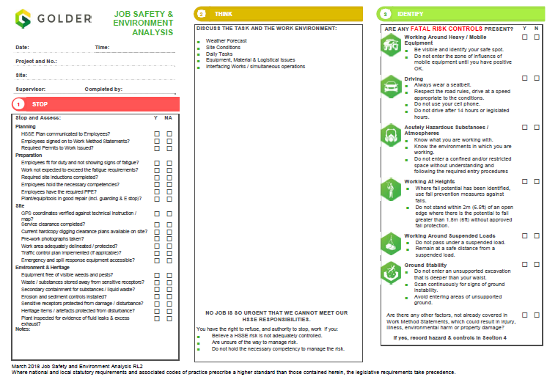
Notes:
The JSEA is a risk tool outlining a communication process to enable you to do the following:
Know your role and the roles of applicable stakeholders
Involve other stakeholders and listen to suggestions
Check for understanding
Stop and ask yourself:
Is the planning complete?
Have required preparations been completed?
Is the site ready for Golder and other personnel to commence or continue to work?
Are there environmental or heritage considerations?
Think:
Are the conditions in the work location the same as considered at the planning stage, e.g. weather, site conditions?
Are there daily tasks that require action?
Are plant / equipment and materials of a type and condition as was anticipated?
Are there other operations that might impact our work? Or that our operations might impact?
3. Identify:
Consider our approach to Fatality Prevention
Are there any Fatal Risks present? If so, are the Fatal Risk Controls understood and will they be implemented and continue to be implemented?

Slide 45
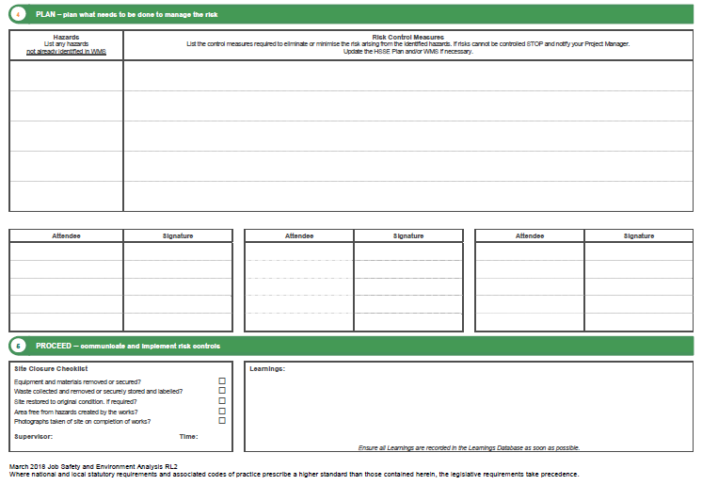
Notes:
4. Plan:
Plan what needs to be done to effectively manage the risk
Are there any other factors, not already covered, that could impact our ability to undertake the work or continue to work? If so identify the hazards and control measures on the back for the JSEA form.
Update the HSSE Plan and Work Method Statement, if required.
Communicate the changes to the applicable stakeholders and verify sign off confirming that they understand the changes and new controls
5. Proceed:
Communicate and implement risk controls
When finished confirm that the location has been left in the appropriate condition
Enter any learnings in the Learnings Database for continual improvement of our systems and processes

Slide 46
JOB SAFETY & ENVIRONMENT ANALYSIS EXERCISE

Slide 47
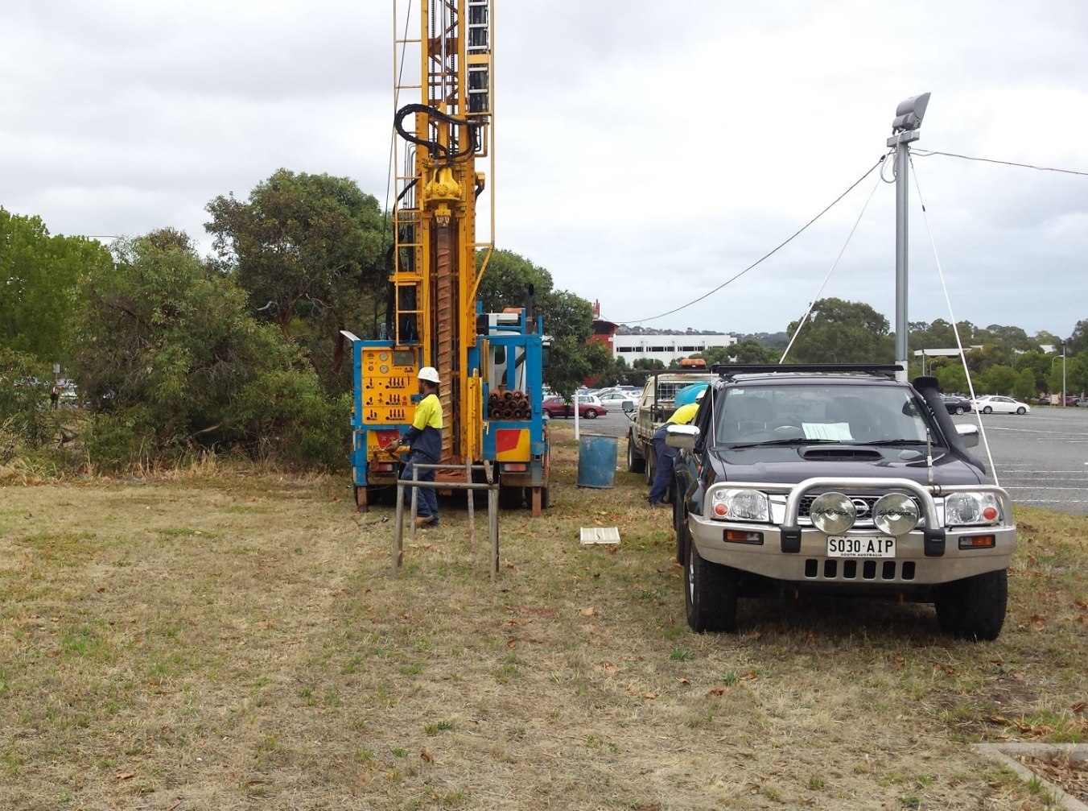
JSEA Exercise
This photo was taken as the drill rig crew was establishing the site for borehole logging and sampling task. The task involved drilling a geotechnical borehole to a depth of 20 m.
Third party intervention/delineation of work areas
Power-line
Potential for Hazardous Fauna (snakes), needles in amongst the dense scrub.
Potential indicators of underground services
Access/Egress (ground condition, hidden objects that could cause a puncture to a tyre etc.)
Dry grass and any potential to spark a fire
Notes:
As you can see on the screen, this team is getting ready to conduct borehole logging and sampling.
Looking at the picture, can you identify the hazard items to be considered prior to undertaking the work?
[Text below to be placed somewhere in the slide so user can drag and drop, or create a list on the screen where they can select/check the items that apply]
Access/Egress (ground condition, hidden objects that could cause a puncture to a tyre etc.)
Power-line
Third party intervention/delineation of work areas.
Dry grass and any potential to spark a fire
Potential for Hazardous Fauna (snakes), needles in amongst the dense scrub.
Potential indicators of underground services

Slide 48
Project Risk Tools Checklist
 Journey Management Plan
 Work Method Statement
 Job Safety & Environment Analysis
 Take 5

Slide 49
Take 5
Take 5
What | A dynamic risk assessment process undertaken to assess personal risk
When | Continually
Who | All personnel
Notes:
Take 5 is a dynamic risk assessment process that is to be implemented by individuals during the work day or in response to new or changing work conditions.
The Take 5 process shall be applied prior to undertaking work activities, during the performance of the task and when a change is anticipated or unexpected condition is identified.

Slide 50
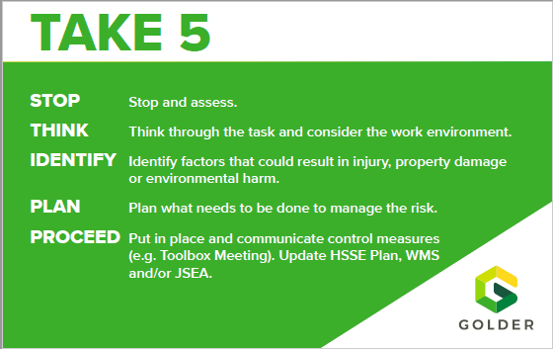
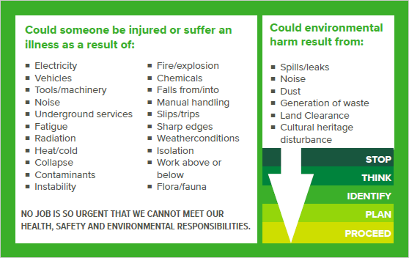
Take 5
Notes:
Before work, during work, or when a change to your workplace conditions is being introduced:
Stop Take time to stop and step back.
Think Take adequate time to think through the decision, the work underway and conditions and the potential consequences impacting you and / or impacting others.
Identify Identify the outcome options and weigh the pros and cons for each option.
Plan Make your decision. Plan how you will go about implementing your decision. What will you do to establish that you and / or others can continue to work safely?
Proceed Take the steps to communicate and action your decision so that you and others can continue to work safely.

Slide 51
TAKE 5 EXERCISE

Slide 52
Take 5 Exercise
Match pairs by selecting the steps, then selecting the example
STOP
THINK
IDENTIFY
PLAN
PROCEED
Notes:
Your supervisor tells you that you will be collecting samples, you decide to apply the Take 5 approach before starting the task. Can you match each step with the example that illustrates that step?
It rained heavily last night, so you check the ground and find some extremely slippery areas.
You take a step back to think about the hazards
Avoiding slippery areas could save you from falling, possibly while carrying objects.
You begin working.
You put plywood over some of the danger areas and use flagging tape to fence off others

Slide 53
In Summary
We’ve now looked at some risk tools for addressing HSSE risks in our projects. The project risk tools will help us manage different levels of risk through the project lifecycle. Let’s recap what we’ve covered.
The HSSE plan is the ‘Big Picture’ planning tool. It captures the high level risks and controls for the project.
There are 4 key aspects of a Journey Management Plan (JMP) that will help you ensure a safe journey: the planning, the preparation, undertaking the journey, and sharing learnings after the journey is completed.
The Job Safety & Environment Analysis (JSEA) assists us with doing a final check when we are in the field.
The Work Method Statement (WMS) helps us plan for field tasks.
The Take 5 approach facilitates an ongoing check of conditions in the field to ensure we remain aware of the risks around us.
Notes:
We’ve arrived to the end of the course. This module has been about increasing your awareness of the tools and resources we have at Golder to help you keep yourself and others safe.
Risk management is not something that happens just once. It’s an ongoing core competency of safe companies in any industry.
We encourage you to reach out to HSSE specialists and/or experienced project managers for additional support. Everyone at Golder is going through this training and we encourage ongoing feedback and communication to improve our tools and systems. Thank you

Slide 54
FINAL EXERCISE

Slide 55
True or False?
A Work Method Statement must be developed for every project
All Journey Management Plans must include a check-in process, means of communication and emergency arrangements
A Journey Management Plan is not necessary for domestic trips
A Job Safety and Environmental Analysis must be completed before mobilizing to site
A Work Method Statement must be developed by the Project Manager alone
The Take 5 approach involves the following steps: Stop, Think, Identify, Plan, and Proceed
Notes:
1. False. A WMS is needed for
High risk activities
Activities not included in the project HSSE Plan
Other activities specified by the Client or Principal Contractor
2. True.
3. False. The JSEA must be completed in the field before initiating the work and as conditions change to identify, assess and control new hazards.
4. False. A JMP must be prepared if risk factors are present such as travel to/through remote areas, rough terrain or extreme weather conditions.
5. False. The WMS must be developed in collaboration with the employees who will be conducting the task. All persons performing a role in the task are required to read the WMS and sign it to verify they are aware of the necessary controls and their responsibility to adopt these controls.
6. True. We follow these 5 steps to assess new or changed circumstances and decide how to proceed in a safe manner.

Slide 56
Further Information
More details on the Global HSSE Project Risk Tools can be found in the Global HSSE Manual, GP5: Management of HSSE and the supporting Global Management Procedures, which are accessible through the Global GAIMS site
If you have any queries please contact your local HSSE Team. Check out the Global HSSE Site for Regional HSSE Leader contact information.
Please charge your time to in-house HSSE Training using NC104, phase 5000, and your home org number
Notes:
To summarise the risk tools we have covered:
The HSSE Plan prepares for and assists in the effective management of project risk and considers the big picture and identifies high level controls.
The Work Method Statement is used to manage task-related risks and is focused on each step of a task.
Both of these tools can be used and completed prior to going to site as they are based on anticipated conditions, work and risk.
The Job Safety & Environment Analysis, or JSEA, is used to manage situational risk and verifies that what we find in the workplace is what we had anticipated and expected.
And the Take 5 is used to manage personal risk and support the practice of ongoing situational awareness.
Both of these tools are used and completed at the work location
You have now completed the introduction to the Global HSSE Risk Tools. If you have additional questions or need more information pertaining to the Global HSSE Risk Tools, please see GP5—Management of HSSE, the Global Health, Safety, Security and Environment Manual accessible through the GAIMS site or speak with your local HSSE Team. Thank you for completing this training. You can charge your time for this in-house HSSE training to project code NC401 phase 5000 and your home org number.

